Slide 1

STUDENT NAME: KANISHKA
REGISTER NO AND NMID: 24BCA102 & 99B1F4D1DBA8F12AF6F4ADC6832D82AD
DEPARTMENT: BCA
COLLEGE: Mohamed Sathak College of Arts and Science
1

Slide 2

PROJECT TITLE
DIGITAL PORTFOLIO
2

Slide 3



AGENDA
1.Problem Statement 2.Project Overview 3.End Users 4.Tools and Technologies 5.Portfolio design and Layout 6.Features and Functionality 7.Results and Screenshots 8. Conclusion 9.Github Link
3/21/2024 Annual Review
3

Slide 4


PROBLEM STATEMENT
In today’s competitive digital world, individuals lack a centralized, professional, and visually appealing platform to showcase their academic achievements, skills, and projects. A digital portfolio is necessary to present personal and professional information effectively.
4

Slide 5

PROJECT OVERVIEW
TheDigital Portfolio Websiteis a personal platform
designed to highlight academic, technical, and creative skills. It contains sections such as About Me, Education, Projects, Skills, Certifications, and Contact information. The website is responsive, user-friendly, and customizable.
5

Slide 6
WHO ARE THE END USERS?
Students – Showcase academic achievements and skills Job Seekers – Highlight projects and certifications Professionals – Build an online personal brand Recruiters/Employers – View candidate portfolios easily
6

Slide 7

TOOLS AND TECHNIQUES
Frontend: HTML, CSS,JavaScript, Bootstrap
Backend: Python (Flask/Django) or PHP (if required)
Database: MySQL / SQLite (optional)
Hosting: GitHub Pages / Netlify
Version Control: Git & GitHub
7

Slide 8

POTFOLIO DESIGN AND LAYOUT
The design follows a clean, minimal, and professional layout with proper navigation. Sections include: Home, About, Skills, Projects, Education, Certifications, and Contact. The portfolio is responsive for both desktop and mobile devices.
8

Slide 9
FEATURES AND FUNCTIONALITY
User-friendly interface with smooth navigation
Responsive design for mobile and desktop
Sections for About, Projects, Skills, and Contact
Integration with LinkedIn/GitHub
Downloadable Resume option

Slide 10
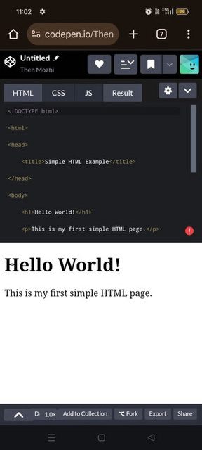
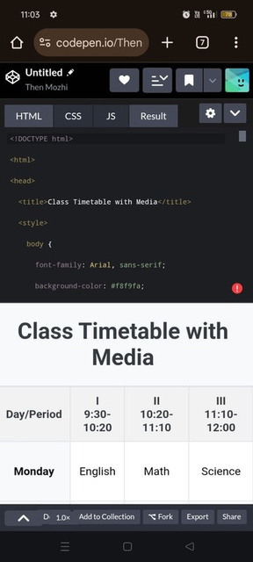

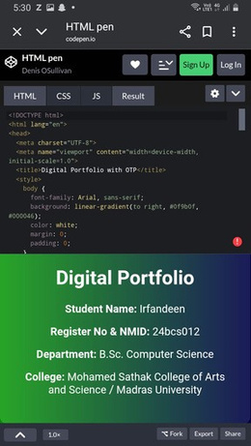
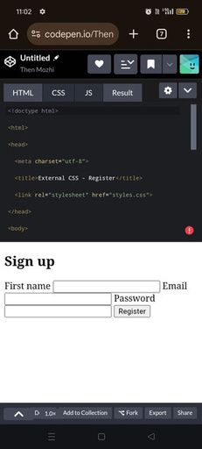
RESULTS AND SCREENSHOTS
3/21/2024 Annual Review
10

Slide 11
CONCLUSION
The Digital Portfolio Website provides an organized and professional way to present personal achievements, skills, and projects.
It enhances career opportunities and creates a strong digital presence
11

